Slide 1
SIT313 - Developing Client Server Web Application
Developing Client-Server Web Applications
Name: Sameera Dinusha Priyananda
SID:2151 215158268
Project 01

Slide 2
What did I implemented
100% of game functions done – (8 - 10 days)
Game testing – All Errors fixed – ( 3 -4 days)
Game Testing – Install 2 android devices and test the game
Multi Screen – Two Screens app

Slide 3
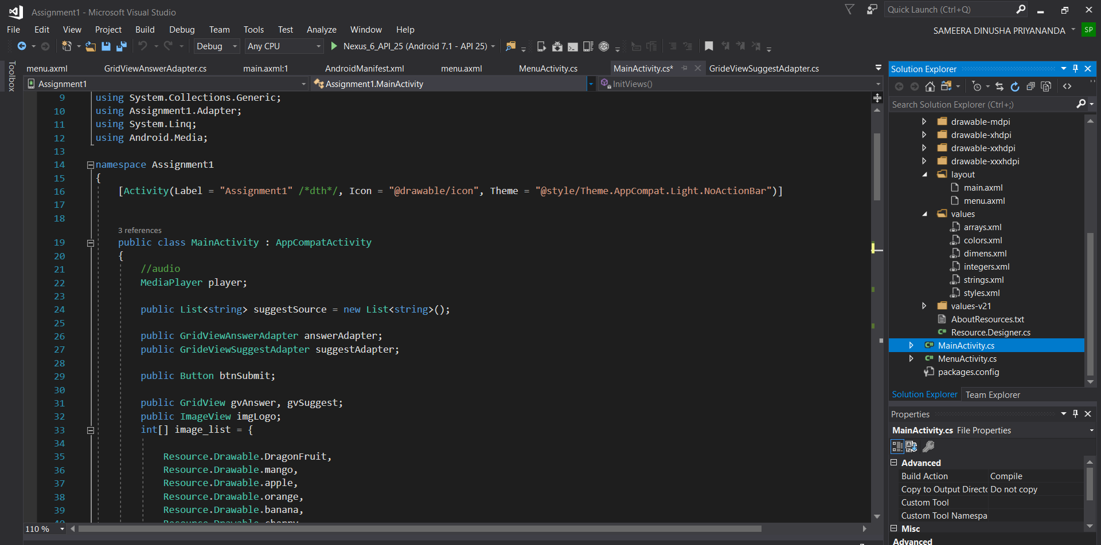
Screenshots of app code

Slide 4
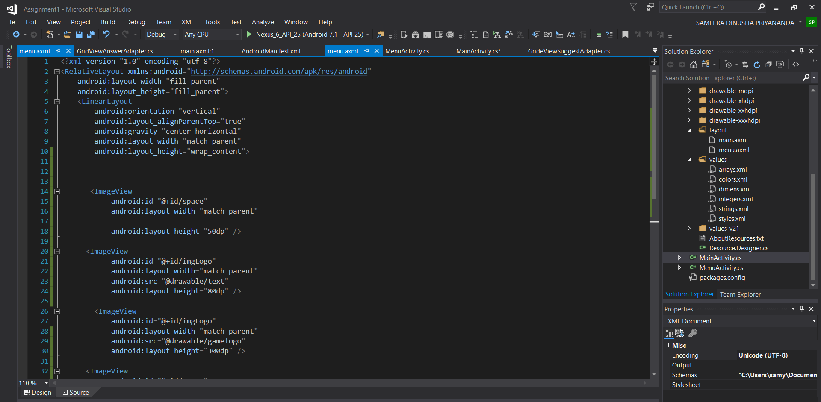
Screenshots of app code

Slide 5
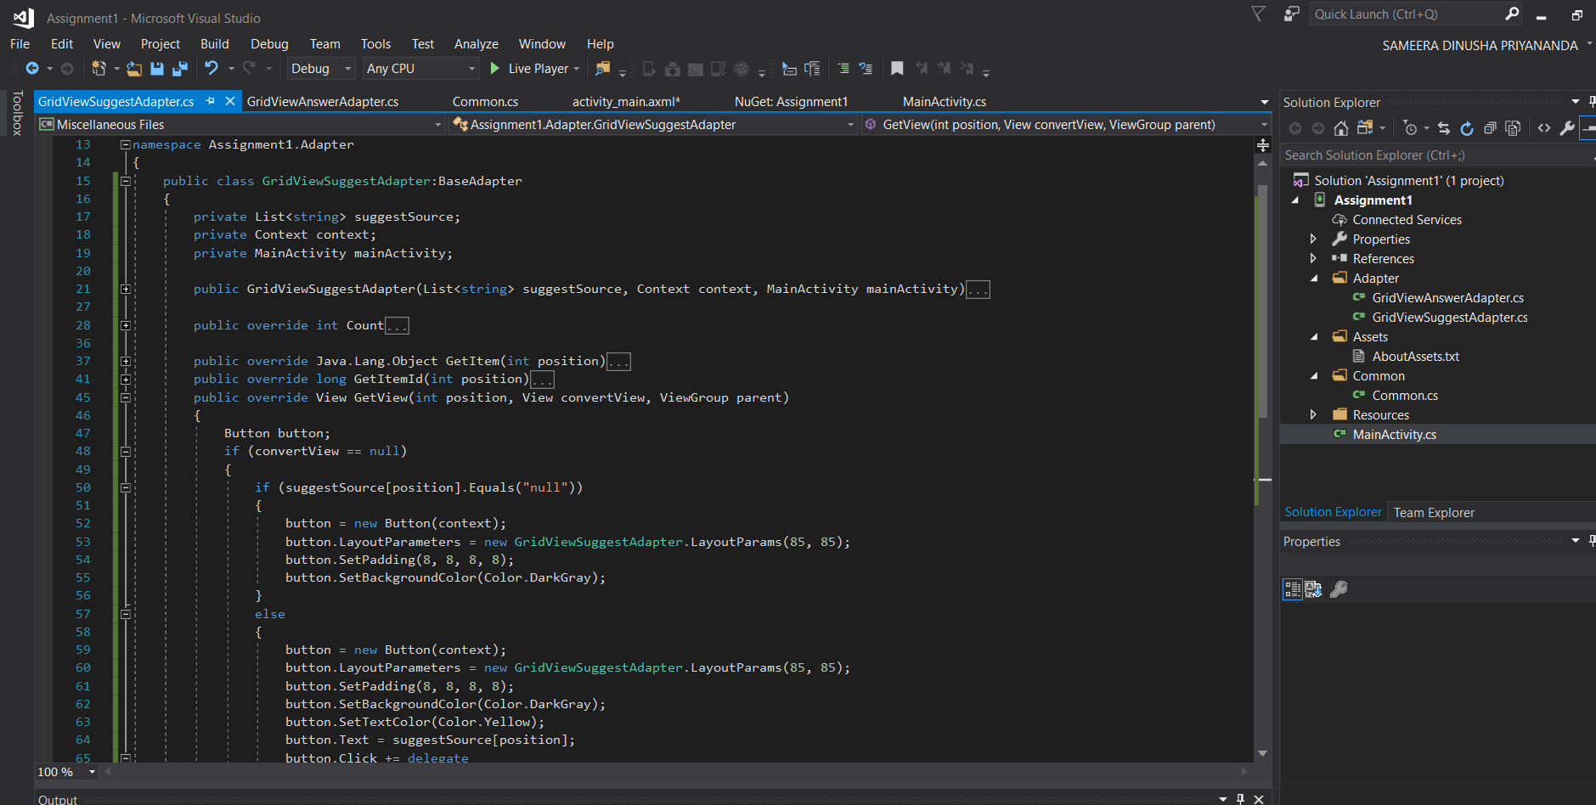
Screenshots of app code

Slide 6
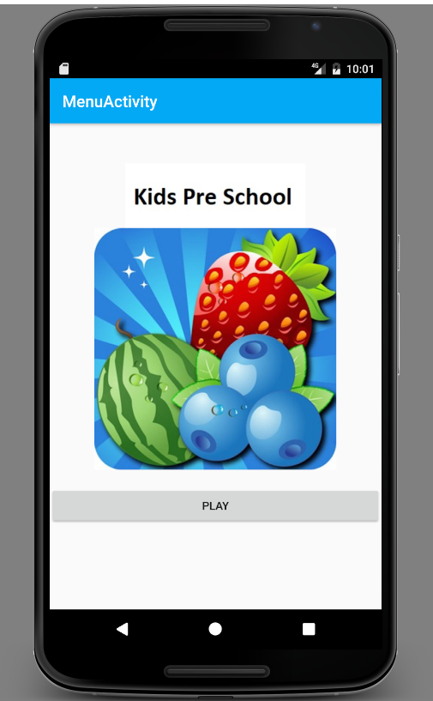
Screenshots of App

Slide 7
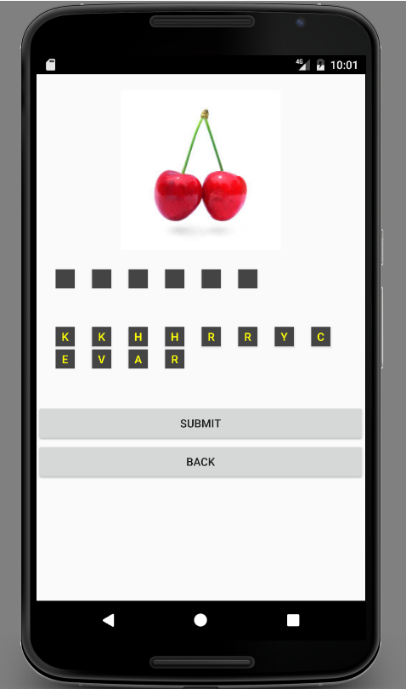
Screenshots of App

Slide 8
GitHub Link
https://github.com/samara92/SIT313_Project1
Project Proposal Video Link: https://github.com/samara92/SIT313_Project1/blob/master/Project%20proposal%20video.mp4
Project Progress Video Link: https://github.com/samara92/SIT313_Project1/blob/master/project_progress.mp4
Final Project Video Link: https://github.com/samara92/SIT313_Project1/blob/master/Final%20Project%20video.m4v

Slide 9
Thank You

